Slide 1
Load Balancing and Auto Scaling
Notes:
https://courses.cs.washington.edu/courses/cse403/13au/lectures/git.ppt.pdf
http://enos.itcollege.ee/~jpoial/allalaadimised/git/getting-started-with-git.pdf

Slide 2
Scalability & High Availability
Scalability means that an application / system can handle greater loads by adapting.
There are two kinds of scalability:
Vertical Scalability
Horizontal Scalability (= elasticity)
Scalability is linked but different to High Availability
Let’s deep dive into the distinction, using a call center as an example

Slide 3

Vertical Scalability
Means increasing the size of the instance
For example, your application runs on a t2.micro
Scaling that application vertically means running it on a t2.large
Vertical scalability is very common for non distributed systems, such as a database.
RDS, ElastiCache are services that can scale vertically.
There’s usually a limit to how much you can vertically scale (hardware limit)

Slide 4
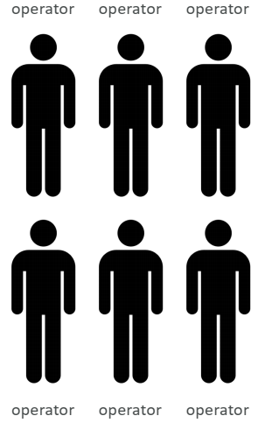
Horizontal Scalability
Horizontal Scalability means increasing the number of instances / systems for your application
Horizontal scaling implies distributed systems.
This is very common for web applications / modern applications
It’s easy to horizontally scale

Slide 5
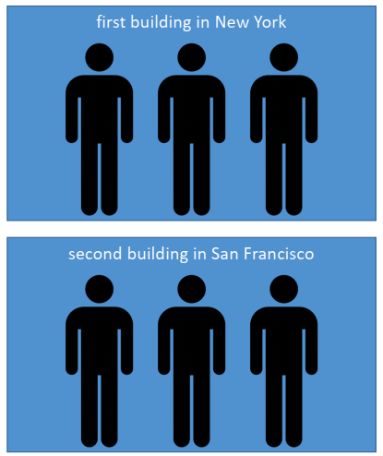
High Availability
Running your application / system in at least 2 data centers (== Availability Zones)
The goal of high availability is to survive a data center loss

Slide 6
High Availability & Scalability For EC2
Vertical Scaling: Increase instance size (= scale up / down)
From: t2.nano - 0.5G of RAM, 1 vCPU
To: u-12tb1.metal – 12.3 TB of RAM, 448 vCPUs
Horizontal Scaling: Increase number of instances (= scale out / in)
Auto Scaling Group
Load Balancer
High Availability: Run instances for the same application across multi AZ
Auto Scaling Group multi AZ
Load Balancer multi AZ

Slide 7
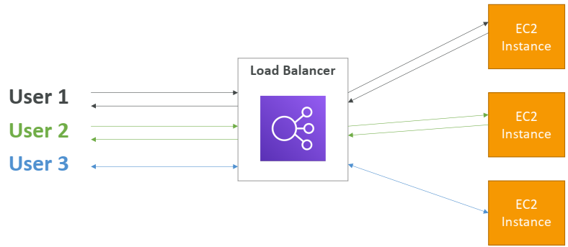
What is load balancing?
Load balancers are servers that forward internet traffic to multiple servers (EC2 Instances).

Slide 8
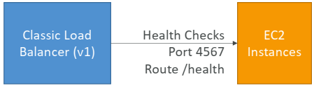
Health Checks
Health Checks are crucial for Load Balancers
They enable the load balancer to know if instances it forwards traffic to are available to reply to requests
The health check is done on a port and a route (/health is common)
If the response is not 200 (OK), then the instance is unhealthy

Slide 9
Types of load balancer on AWS
AWS has 3 kinds of managed Load Balancers
Classic Load Balancer (v1 - old generation) – 2009
HTTP, HTTPS, TCP
Application Load Balancer (v2 - new generation) – 2016
HTTP, HTTPS, WebSocket
Network Load Balancer (v2 - new generation) – 2017
TCP, TLS (secure TCP) & UDP
Overall, it is recommended to use the newer / v2 generation load balancers as they provide more features

Slide 10
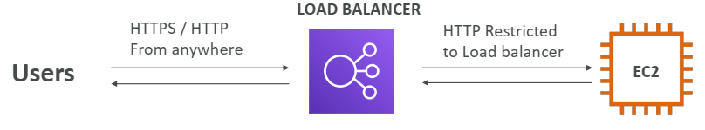
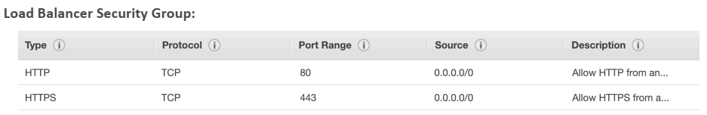
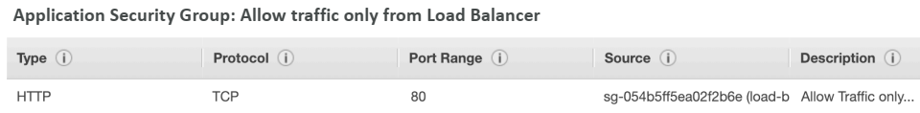
Load Balancer Security Groups

Slide 11
Application Load Balancer (v2)
Application load balancers is Layer 7 (HTTP)
Load balancing to multiple HTTP applications across machines (target groups)
Load balancing to multiple applications on the same machine (ex: containers)
Routing tables to different target groups:
Routing based on path in URL (example.com/users & example.com/posts)
Routing based on hostname in URL (one.example.com & other.example.com)
Routing based on Query String, Headers (example.com/users?id=123&order=false)

Slide 12
Hands-On: Load Balancer

Slide 13
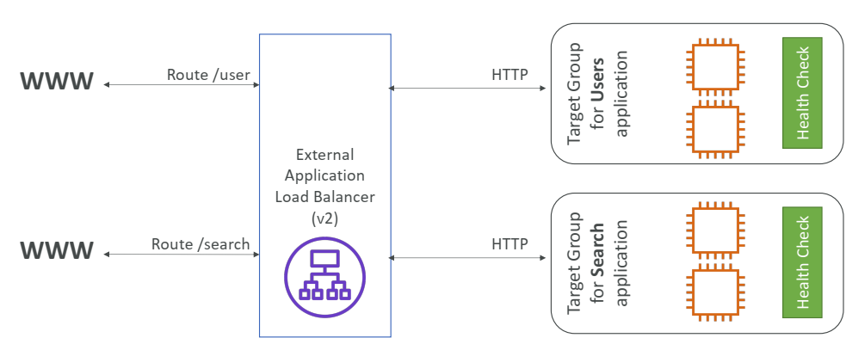
Application Load Balancer (v2)

Slide 14
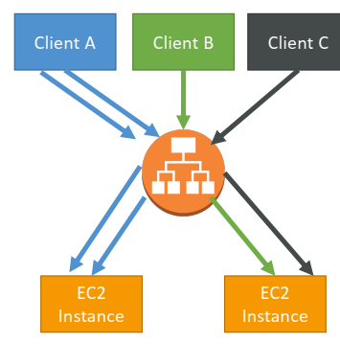
Load Balancer Stickiness
It is possible to implement stickiness so that the same client is always redirected to the same instance behind a load Balancer
The “cookie” used for stickiness has an expiration date you control
Enabling stickiness may bring imbalance to the load over the backend EC2 instances

Slide 15
Hands-On: Load Balancer Stickiness

Slide 16
Auto Scaling Group
In real-life, the load on your websites and application can change
In the cloud, you can create and get rid of servers very quickly
The goal of an Auto Scaling Group (ASG) is to:
Scale out (add EC2 instances) to match an increased load
Scale in (remove EC2 instances) to match a decreased load
Ensure we have a minimum and a maximum number of machines running
Automatically Register new instances to a load balancer

Slide 17
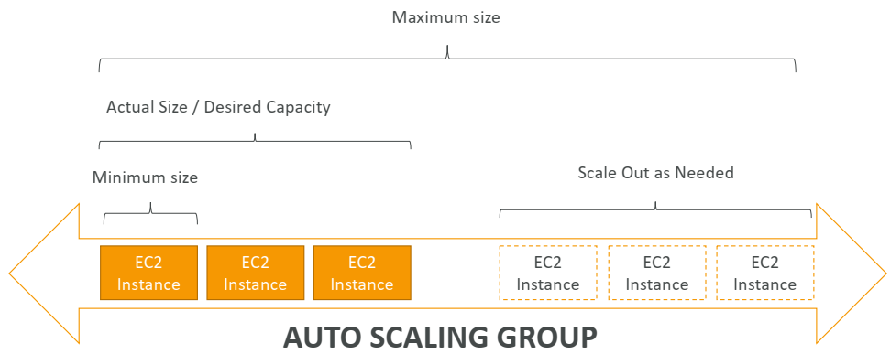
Auto Scaling Group in AWS

Slide 18
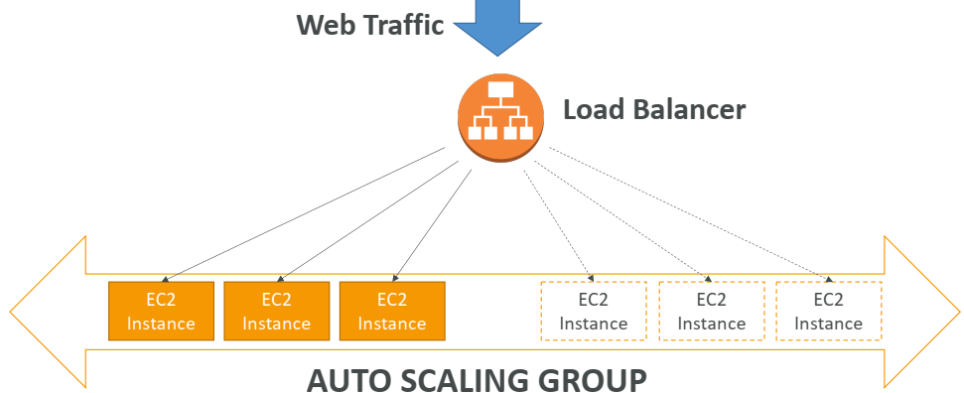
Auto Scaling Group in AWS With Load Balancer

Slide 19
Hands-On: Auto Scaling Group

Slide 20
Hands-On: Assignment
Creating and configuring Elastic Load Balancer to load balance the EC2 instances with sample webapp

Slide 21
Hands-On: Assignment
Creating and configuring Auto Scaling Groups to scale EC2 instances based on configured rules

Slide 22
Thanks

